Slide 1
Debugging in angular
Team-2

Slide 2
AGENDA
Create an Angular application
Click on Run and Debug to add new configuration
Add an component.ts file
Add a Breakpoint
Start Debugging

Slide 3
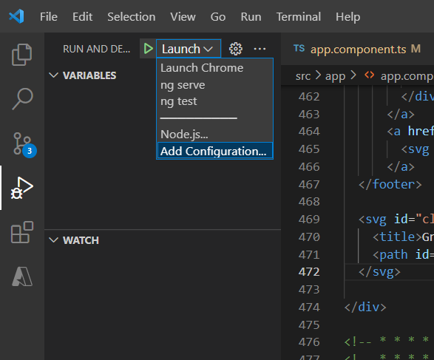
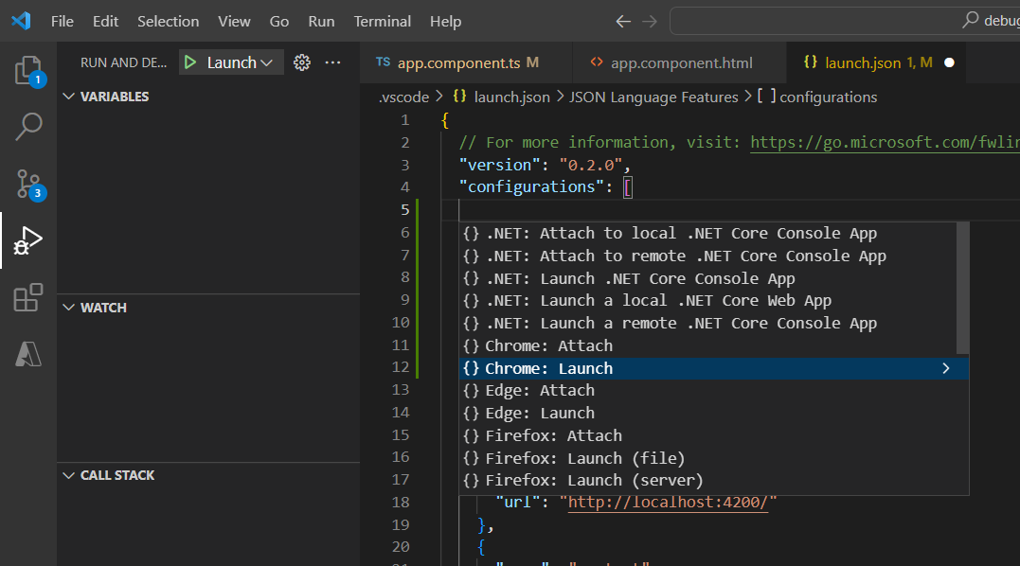
Step 2:

Slide 4
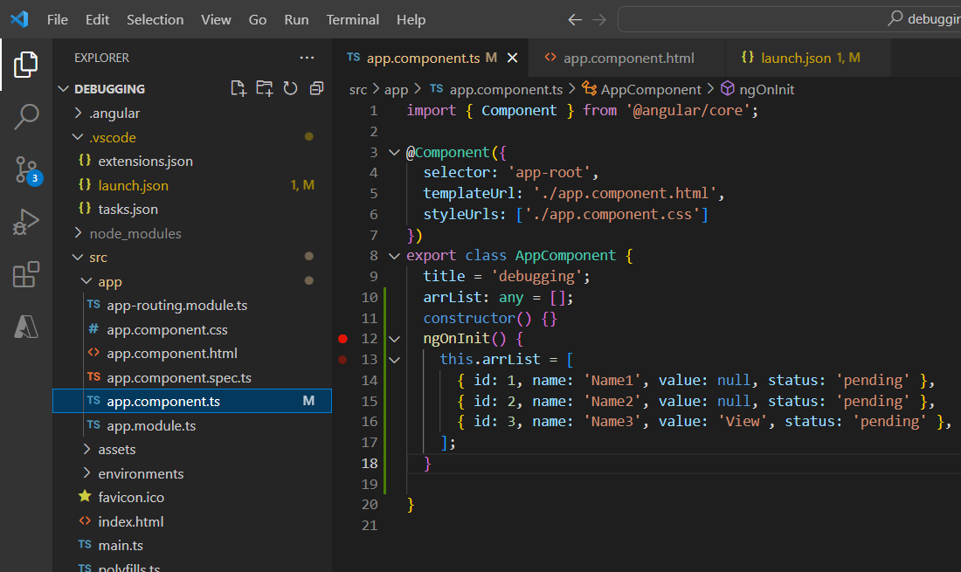
Step 3:

Slide 5
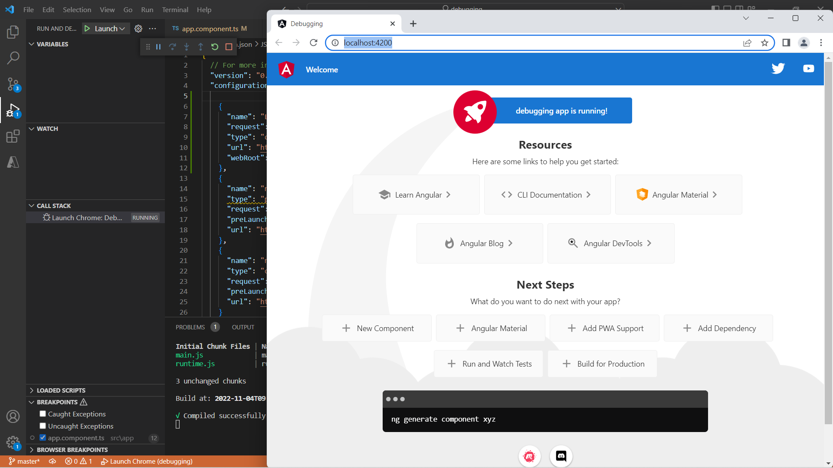
Step 4:

Slide 6
THANK YOU

